Slide 1



VCE Secure Implementation
Haris Adrović
Valento Bardhoshi

Slide 2
Scenario Overview

Slide 3
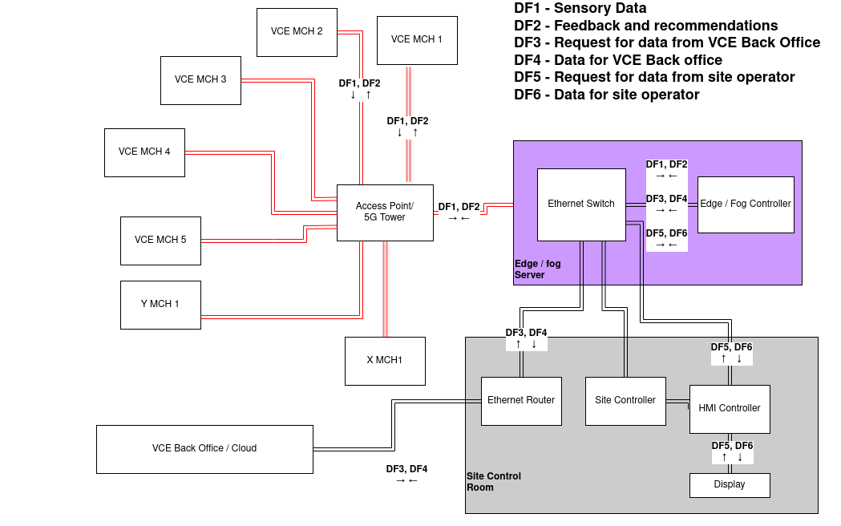
Network Topology

Slide 4


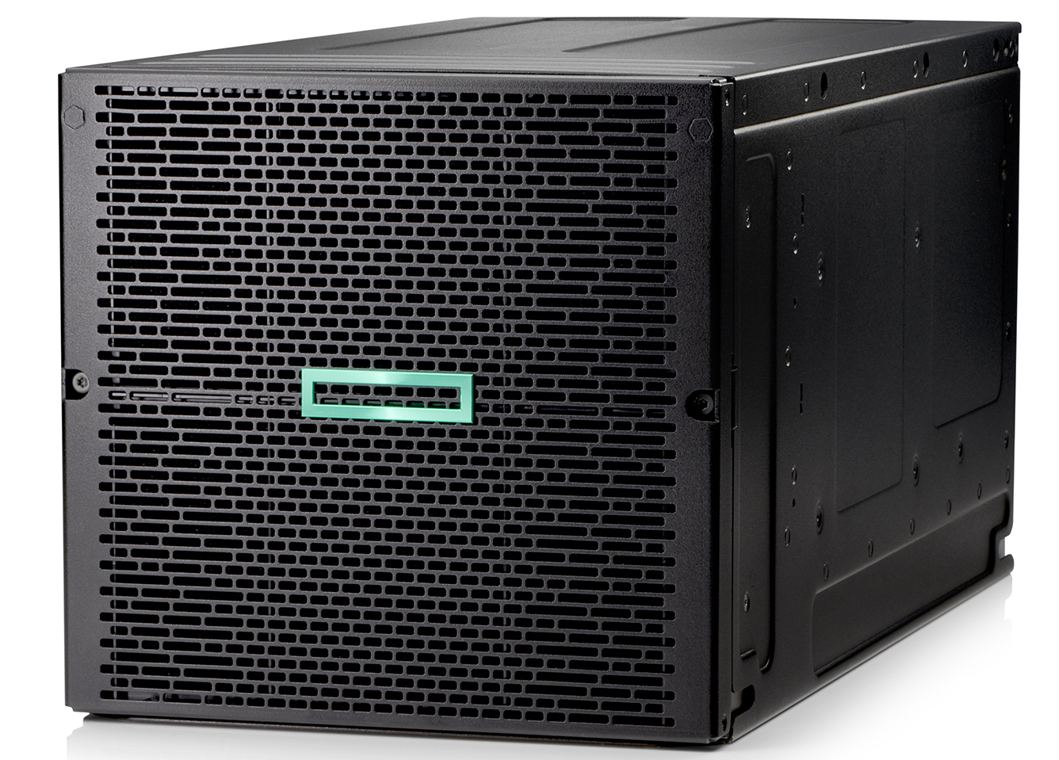

Asset Identification
1. 5G Tower
2. Engine Sensor
3. Machine Efficiency Data
4. Load Sensor
5. Edge / Fog Server
6. iAssist Service​
7. Recommendations
8. Human Machine Interface

Slide 5
Threat Scenario
Asset ID | Damage Scenario | Threat Scenario | Elapsed Time | Expertise | TOE | Window of Opportunity | Equipment
A3.1 | Fake load readings cause inaccurate efficiency data and potentially unsafe load operations. | Attacker modifies load sensor output by compromising sensor firmware or intercepting internal MCH bus. | <= 1 week | Expert | Restricted Information | Difficult | Specialized
A4 | A jamming or flooding attack could disrupt all machine communications, crippling iAssist feedback loops and site operations. | Attackers jam or flood the 5G spectrum, or impersonate the tower to disrupt legitimate traffic. | <= 1 day | Proficient | Public Information | Easy | Specialized
A5 | A compromise of the server can yield false analytics or block iAssist entirely, halting real-time optimizations. | Attackers gain root/admin on the Edge server via OS or application exploit, altering or disabling services. | <= 1 Month | Expert | Strictly Confidential Information | Difficult | Specialized
A7 | A compromised HMI might show falsified site data or leak sensitive operational info, leading to poor decisions or sabotage. | Malware or firmware hack on HMI manipulates displayed data or intercepts user input. | <= 1 week | Proficient | Restricted Information | Moderate | Standard

Slide 6
Risk-Assessment​
Asset ID | Threat Scenario | Likelihood | Impact | Risk Level | Risk Treatment Action | Risk Treatment Action | Cybersecurity Goal
A3.1 | Modifying load sensor output | Medium | Medium | Medium | Mitigate | -Secure firmware with signing -Encrypt sensor output | -Maintain Availiability of real-time analytics -Prevent major service interruptions
A4 | Jamming or flooding the 5G Tower | Medium | High | High | Mitigate | -Anti-jamming/frequency hopping -Hardening base station SW -Network slicing & QoS for critical traffic | -Ensure Availiability of wireless link -Maintain connectivity for iAssist flows
A5 | Gaining root/admin on Fog / Edge Server | Low | High | Medium | Mitigate | -OS/application patching & hardening -Least privilege & strong authentication -Monitoring (IDS) & logging MFA for all privileged logins (local or remote) to prevent stolen credentials from granting root-level access | -Protect integrity of analytics and configuration -Ensure availability of iAssist
A7 | Malware on HMI to display fake data | Medium | High | High | Mitigate | -Secure OS (Disable unnecessary ports/services) -Digital Signing of HMI firmware -Role-based access control -MFA for all HMI logins | -Preserve integrity of displayed info -Protect confidentiality of site data

Slide 7

Trust Boundaries

Slide 8

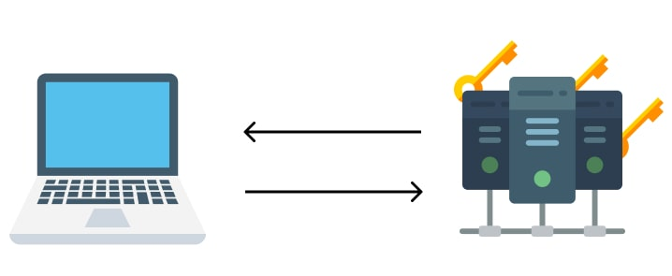







Physical Security
Encrypted Data Output​
​
​
Zero Trust - Mutual Authentication​​
​​​​ ​​
​
Fallback Communication​​​
​​​
OS Security​​​​
​​​​
Least Privilege​​​​​
​​​​​
​
​​​​​​​​
Role-Based Access Control
​
​​​​​​​
Multi Factor Authentication​​​​​​​​​
​
Logging & Monitoring
Network Segmentation
Security Objectives

Slide 9
Cisco Packet Tracer Simulation Video

Slide 10
Thank you for your Attention and Stay Safe!
Any Questions?

